Slide 1

Data Structures And Algorithms Odd Semester 2022
Computer Science and Engineering
Jaypee Institute Of Information Technology (JIIT), Noida

Slide 2
Outline
Introduction to Greedy algorithm
0/1 Knapsack problem using Greedy algorithm

Slide 3
Greedy Algorithm
Greedy algorithm is generally used to solve optimization problems.
Optimization problems
A problem that may have many feasible solutions.
Each solution has a value
Optimization problem can be either maximization or minimization problems, where in maximization problem, we wish to find a solution to maximize the value and in the minimization problem, we wish to find a solution to minimize the value
There are a number of approaches to solve optimization problems. Some of them are given below-
Backtracking
Greedy Method
Dynamic Programming

Slide 4
Greedy Algorithm
Greedy Method finds out of many options, but you have to choose the best option. Optimization problems.
Greedy Algorithm solves problems by making the best choice that seems best at the particular moment.
A greedy algorithm works in phases. At each phase:
You take the best you can get right now, without regard for future consequences
You hope that by choosing a local optimum at each step, you will end up at a global optimum•
Greedy algorithms are simple and straightforward and they take decisions on the basis of information at hand without worrying about the effect these decisions may have in the future.
They are easy to invent, easy to implement and most of the time quite efficient.

Slide 5
Greedy Algorithm
Only a few optimization problems can be solved by the greedy method. Some of them are given below-
machine scheduling
Fractional Knapsack Problem
Minimum Spanning Tree
Huffman Code
Job Sequencing
Activity Selection Problem
Steps for achieving a Greedy Algorithm are:
Feasible: Here we check whether it satisfies all possible constraints or not, to obtain at least one solution to our problems.
Local Optimal Choice: In this, the choice should be the optimum which is selected from the currently available
Unalterable: Once the decision is made, at any subsequence step that option is not altered.

Slide 6
Knapsack Problem using Greedy method
Two main kinds of Knapsack Problems:
0-1 Knapsack:
N items (can be the same or different)
Have only one of each
Must leave or take (i.e., 0-1) each item
Dynamic Programming (DP) works, greedy does not since items cannot be broken
Fractional Knapsack:
N items (can be the same or different)
Can take fractional part of each item (bags of gold dust)
Greedy works and DP algorithms work

Slide 7
Greedy approach for Fractional Knapsack Problem
Steps to solve the Fractional Problem:
Compute the value per pound v_{i}/w_{i} for each item.
Obeying a Greedy Strategy, we take as possible of the item with the highest value per pound.
If the supply of that element is exhausted and we can still carry more, we take as much as possible of the element with the next value per pound.
Sorting, the items by value per pound, the greedy algorithm run in O (n log n) time.
Example: Consider 5 items along their respective weights and values: -
I = (I₁,I₂,I₃,I₄,I₅)
w = (5, 10, 20, 30, 40)
v = (30, 20, 100, 90,160)
The capacity of knapsack W = 60
The greedy algorithm:
Step 1: Sort v_{i}/w_{i} into non-increasing order.
Step 2: Put the objects into the knapsack according to the sorted sequence as possible as we can.

Slide 8
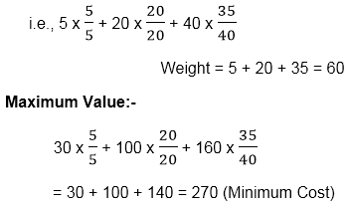
Greedy approach for Fractional Knapsack Problem
Example: Consider 5 items along their respective weights and values: -
The capacity of knapsack W = 60
First, we choose the item I₁ whose weight is 5.
Then choose item I₃ whose weight is 20.
Now, the total weight of knapsack is 20 + 5 = 25
Now the next item is I₅, and its weight is 40, but
we want only 35, so we chose the fractional part of it,
So we arrange the value of V/W in decreasing order as given in table and this will be the solution of given problem.
I | I1 | I2 | I3 | I4 | I5
W | 5 | 10 | 20 | 30 | 40
V | 30 | 20 | 100 | 90 | 160
V/W | 6 | 2 | 5 | 3 | 4
I | I1 | I3 | I5 | I4 | I2
W | 5 | 20 | 40 | 30 | 10
V | 30 | 100 | 160 | 90 | 20
V/W | 6 | 5 | 4 | 3 | 2

Slide 9
O-1 knapsack is harder!
0-1 knapsack cannot be solved by the greedy strategy
Unable to fill the knapsack to capacity, and the empty space lowers the effective value per pound of the packing.
We must compare the solution to the sub-problem in which the item is included with the solution to the sub-problem in which the item is excluded before we can make the choice.
Dynamic Programming

Slide 10
Why greedy not used for 0-1 knapsack?
C
A
B
W=4 pound
(knapsack capacity)
$100
$10
$120
2 pd
2 pd
3 pd

Slide 11
Greedy solution for fractional knapsack
C
A
B
$100
$10
$120
W=4 pound
(knapsack capacity)
2 pd
2 pd
3 pd
Cost per pound = A(50), B(5), C(40)
Sol: 2 pd of Item A + 2 pd of Item C
Total cost of item = $100+$80 => $180

Slide 12
Greedy solution for 0-1 knapsack
C
A
B
$100
W=4 pound
(knapsack capacity)
$10
$120
2 pd
2 pd
3 pd
One can only take or leave item. You can not take a fraction
Cost per pound = A(50), B(5), C(40)
Sol: 2 pound of Item A + 2 pound of Item B
Total cost of item = $100+$10 => $110 < greedy solution ($180)

Slide 13
Greedy does not work for 0-1 knapsack

Slide 14
An Activity Selection Problem

Slide 15
An Activity Selection Problem (Conference Scheduling Problem)
Input: A set of activities S = {a₁,…, a_{n}}
Each activity has start time (s_{i}) and a finish time (f_{i})
a_{i}=(s_{i}, f_{i})
Two activities are compatible if and only if their interval does not overlap.
Output: a maximum-size subset of mutually compatible activities.

Slide 16
Activity-Selection
Formally:
Given a set S of n activities
s_{i} = start time of activity i
f_{i} = finish time of activity i
Find max-size subset A of compatible activities.
3
4
6
2
1
5

Slide 17
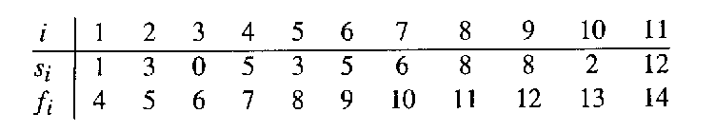
The Activity Selection Problem
Here are a set of start and finish times
What is the maximum number of activities that can be completed?
{a₃, a₉, a₁₁} can be completed
But so can {a₁, a₄, a_{8’} a₁₁} which is a larger set
But it is not unique, consider {a₂, a₄, a_{9’} a₁₁}

Slide 18
Activity Selection: A Greedy Algorithm
So actual algorithm is simple:
Sort the activities by finish time
Schedule the first activity
Then schedule the next activity in sorted list which starts after previous activity finishes
Repeat until no more activities

Slide 19
0 1 2 3 4 5 6 7 8 9 10 11 12 13 14 15

Slide 20
0 1 2 3 4 5 6 7 8 9 10 11 12 13 14 15

Slide 21
0 1 2 3 4 5 6 7 8 9 10 11 12 13 14 15

Slide 22
0 1 2 3 4 5 6 7 8 9 10 11 12 13 14 15

Slide 23
0 1 2 3 4 5 6 7 8 9 10 11 12 13 14 15

Slide 24
0 1 2 3 4 5 6 7 8 9 10 11 12 13 14 15

Slide 25
0 1 2 3 4 5 6 7 8 9 10 11 12 13 14 15

Slide 26
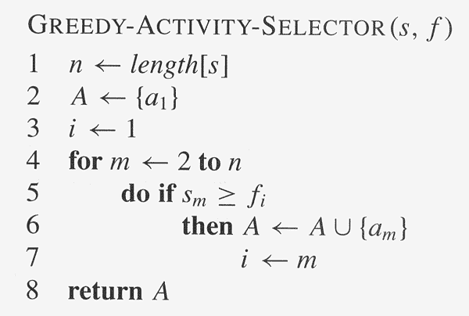
Assuming activities are sorted by finish time

Slide 27
Why it is Greedy?
Greedy in the sense that it leaves as much opportunity as possible for the remaining activities to be scheduled.
The greedy choice is the one that maximizes the amount of unscheduled time remaining.

Slide 28
Greedy Algorithm to find Minimum number of Coins
Suppose we want a change for M Rs and we have an infinite supply of each of the denominations in Indian currency, i.e., we have an infinite supply of {1, 2, 5, 10, 20, 50, 100, 500, 1000} valued coins/notes, what is the minimum number of coins and/or notes needed to make the change?
Input: M = 70
Output: 2
We need a 50 Rs note and a 20 Rs note.
Input: V = 121
Output: 3
We need a 100 Rs note, a 20 Rs note and
a 1 Rs coin.
Algorithm:
Sort the array of coins in decreasing order.
Initialize result as empty.
Find the largest denomination that is smaller than current amount.
Add found denomination to result. Subtract value of found denomination from amount.
If amount becomes 0, then print result.
Else repeat steps 3 and 4 for new value of V
Solution: Greedy Approach.
Note: This approach may not work for all denominations. For example, it doesn’t work for denominations {9, 6, 5, 1} and V = 11. The above approach would print 9, 1 and 1. But we can use 2 denominations 5 and 6. For general input, dynamic programming approach can be used:

Slide 29
References
https://www.javatpoint.com/greedy-algorithms
https://www.radford.edu/~nokie/classes/360/greedy.html
https://www.geeksforgeeks.org/fractional-knapsack-problem

